Slide 1
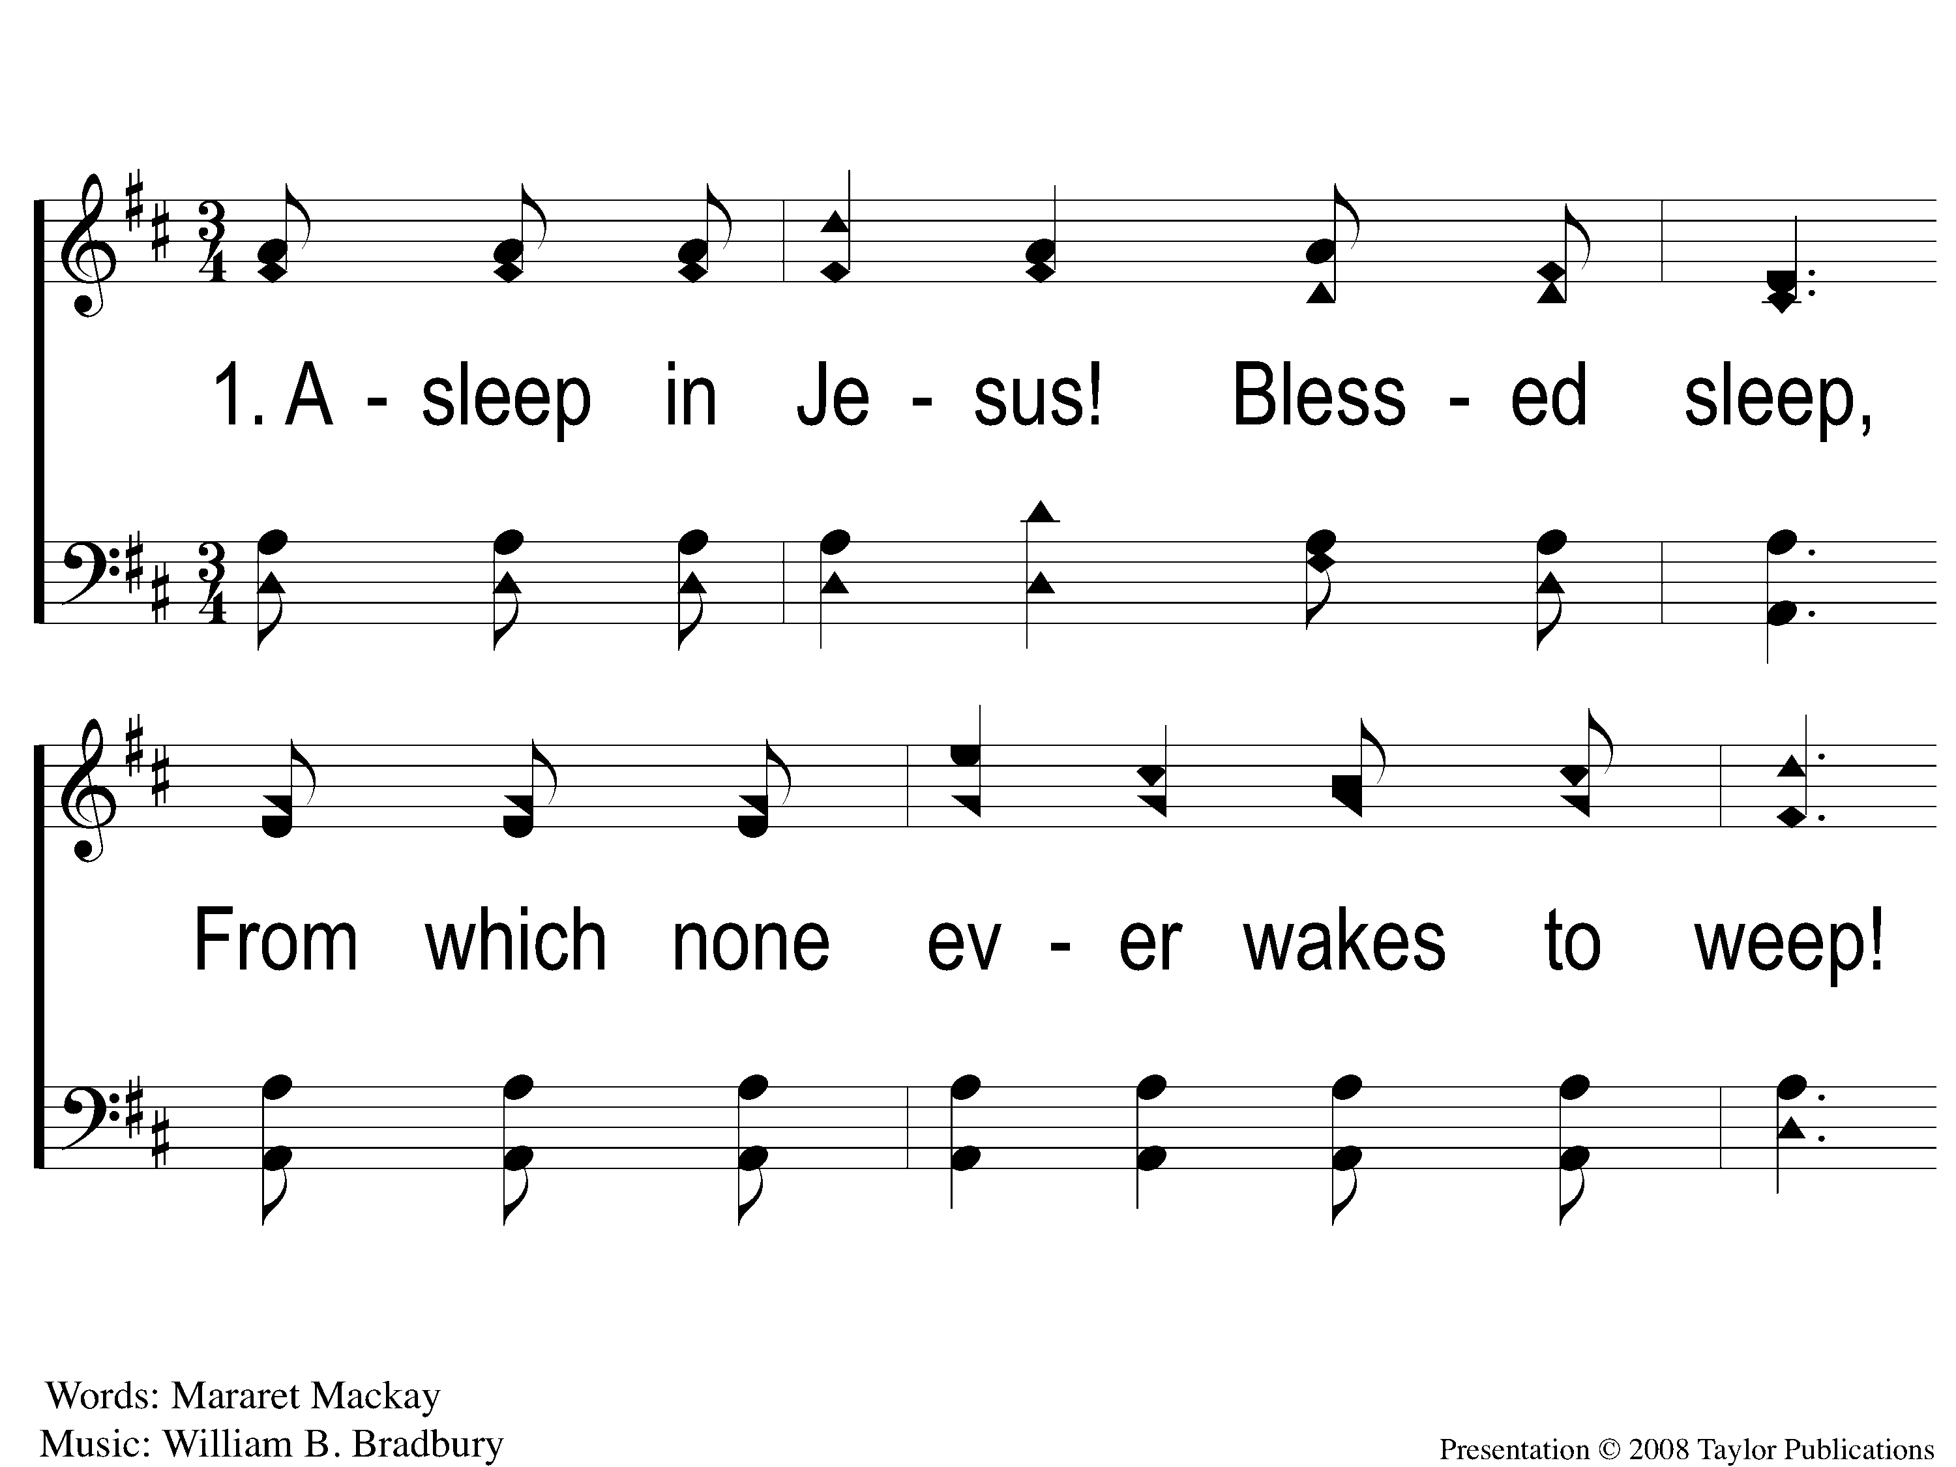
1-1 Asleep In Jesus
Asleep In Jesus
4

Slide 2
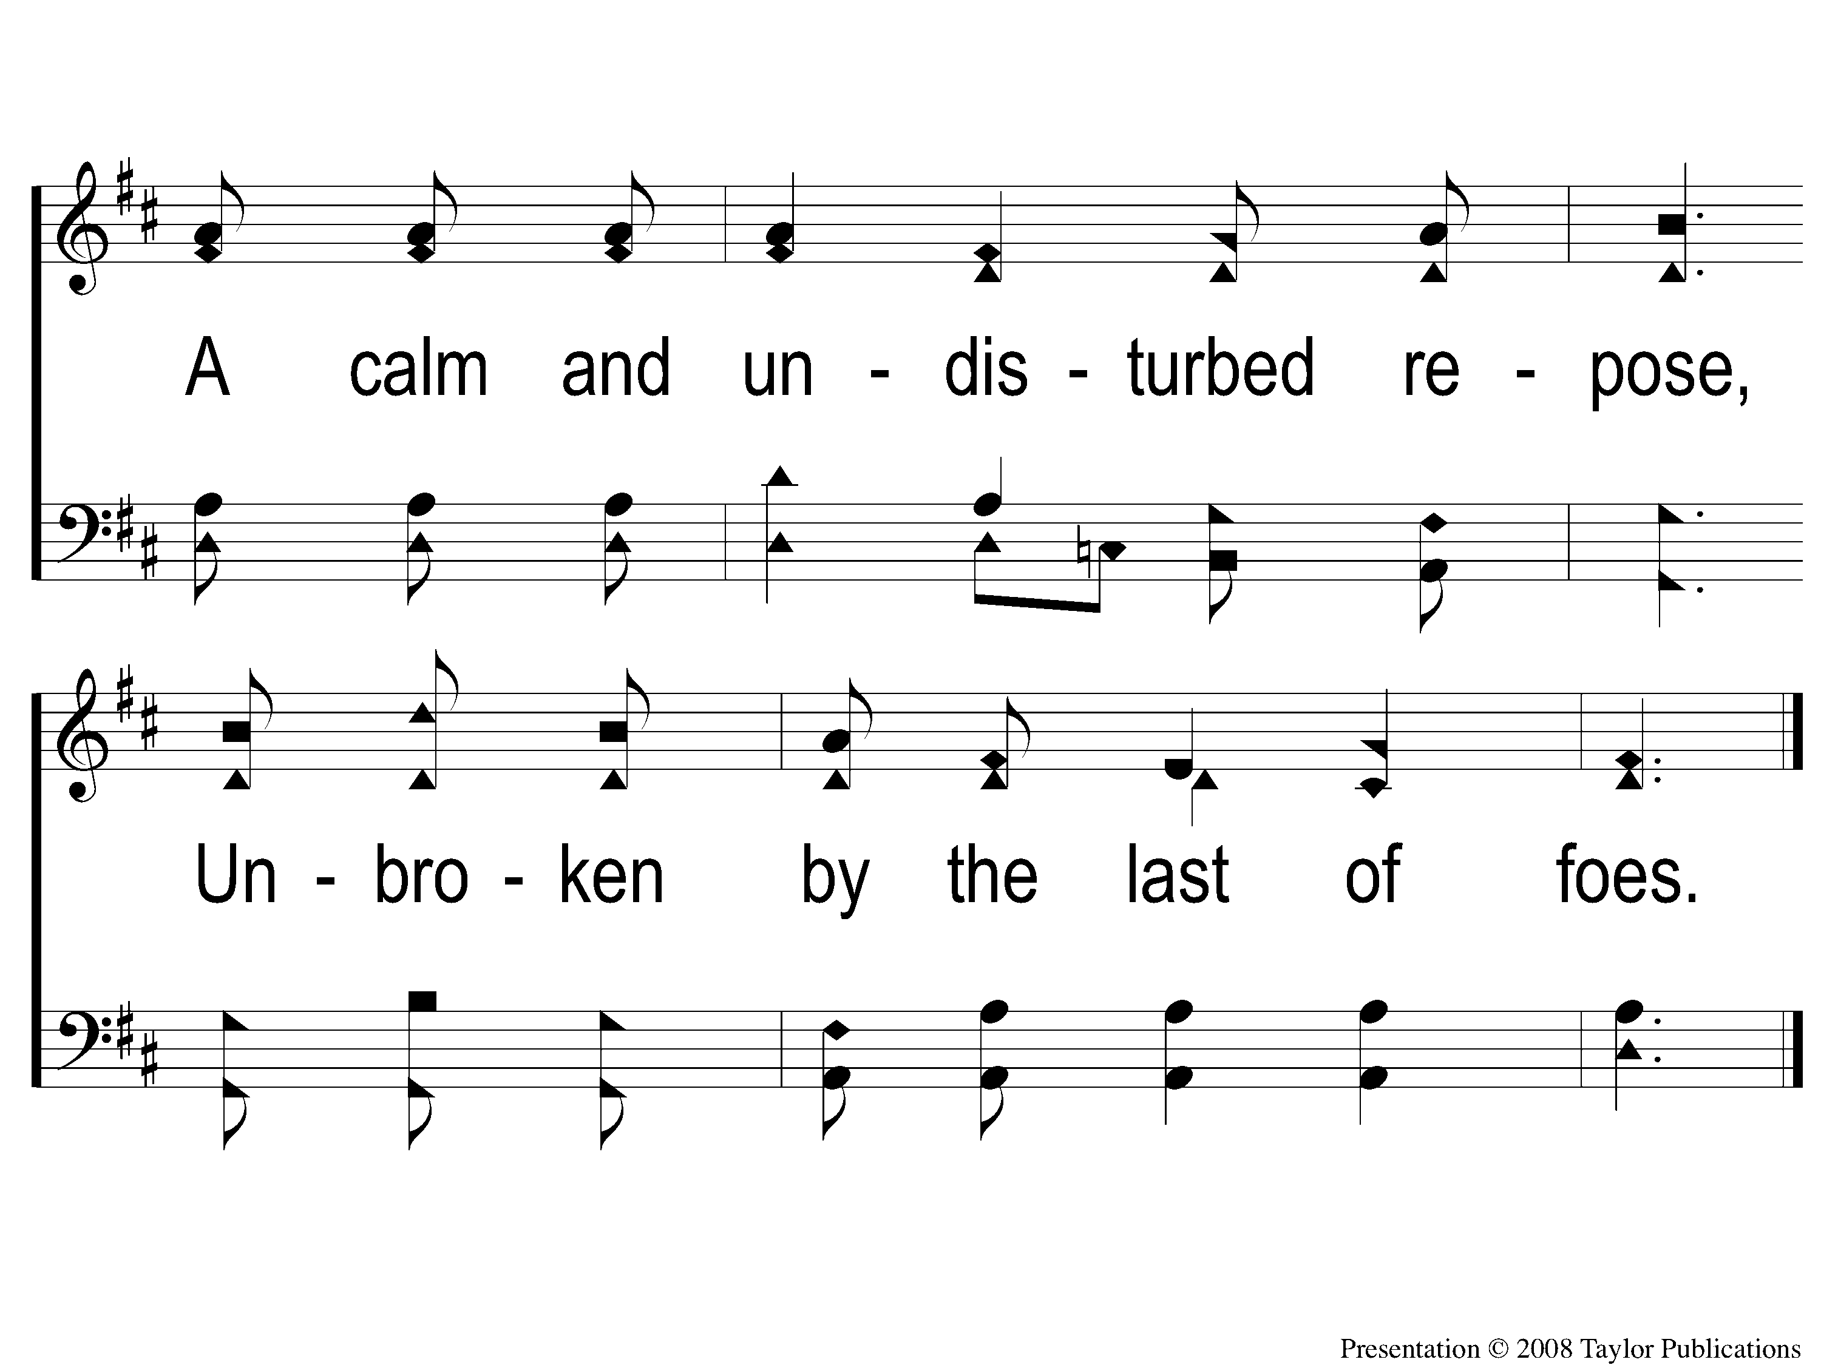
1-2 Asleep In Jesus
Asleep In Jesus
4

Slide 3
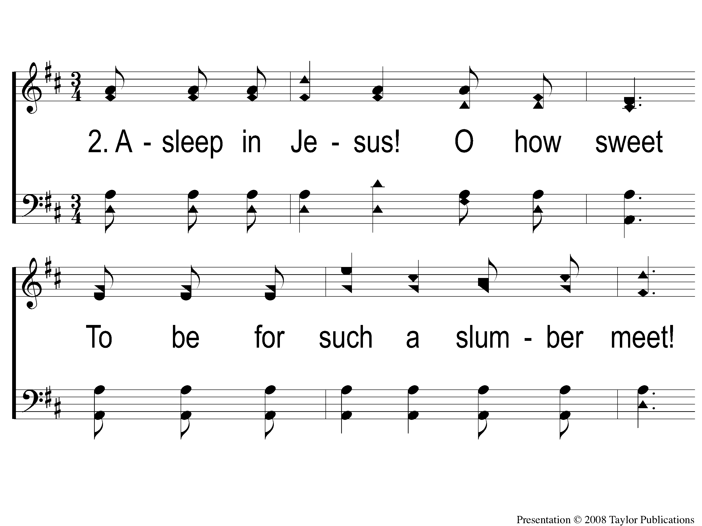
2-1 Asleep In Jesus
Asleep In Jesus
4

Slide 4
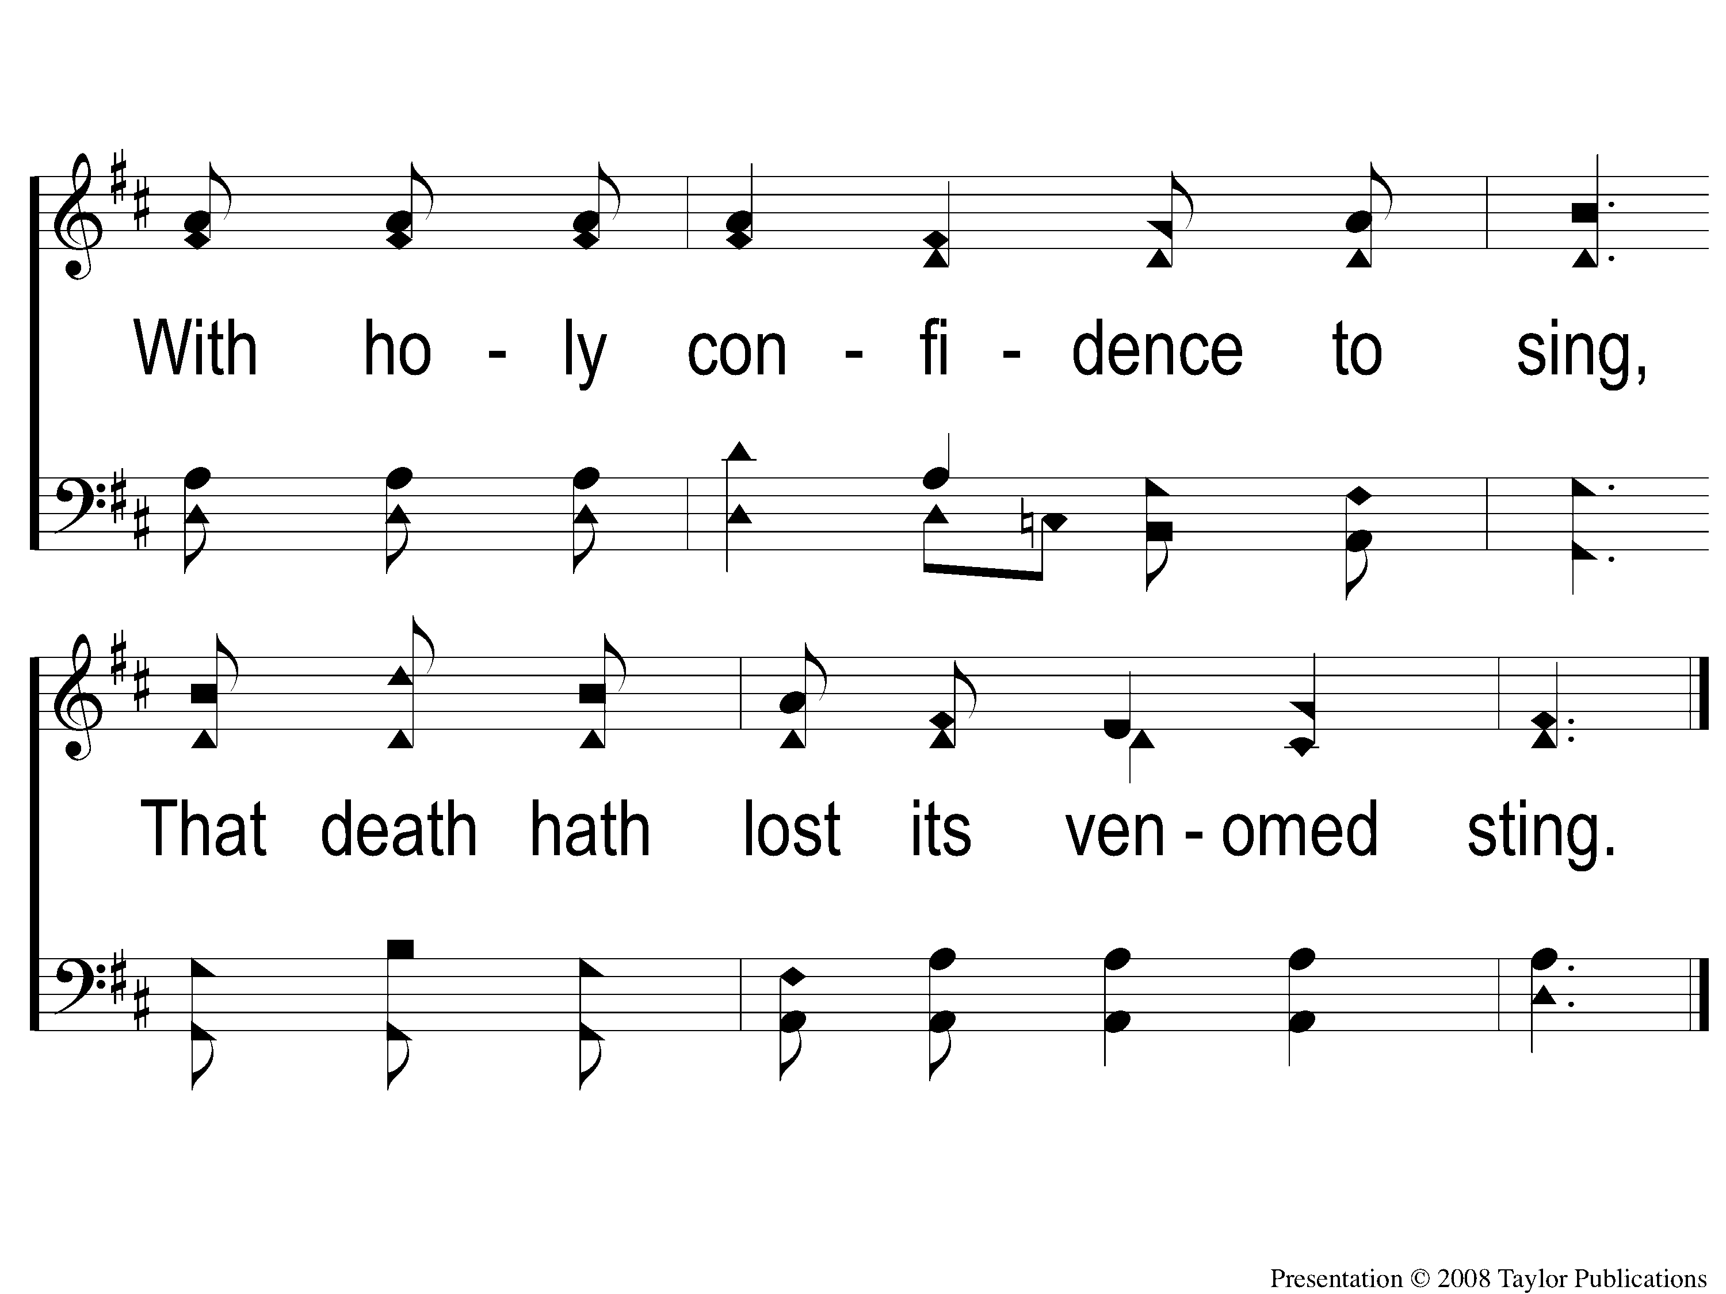
2-2 Asleep In Jesus
Asleep In Jesus
4

Slide 5
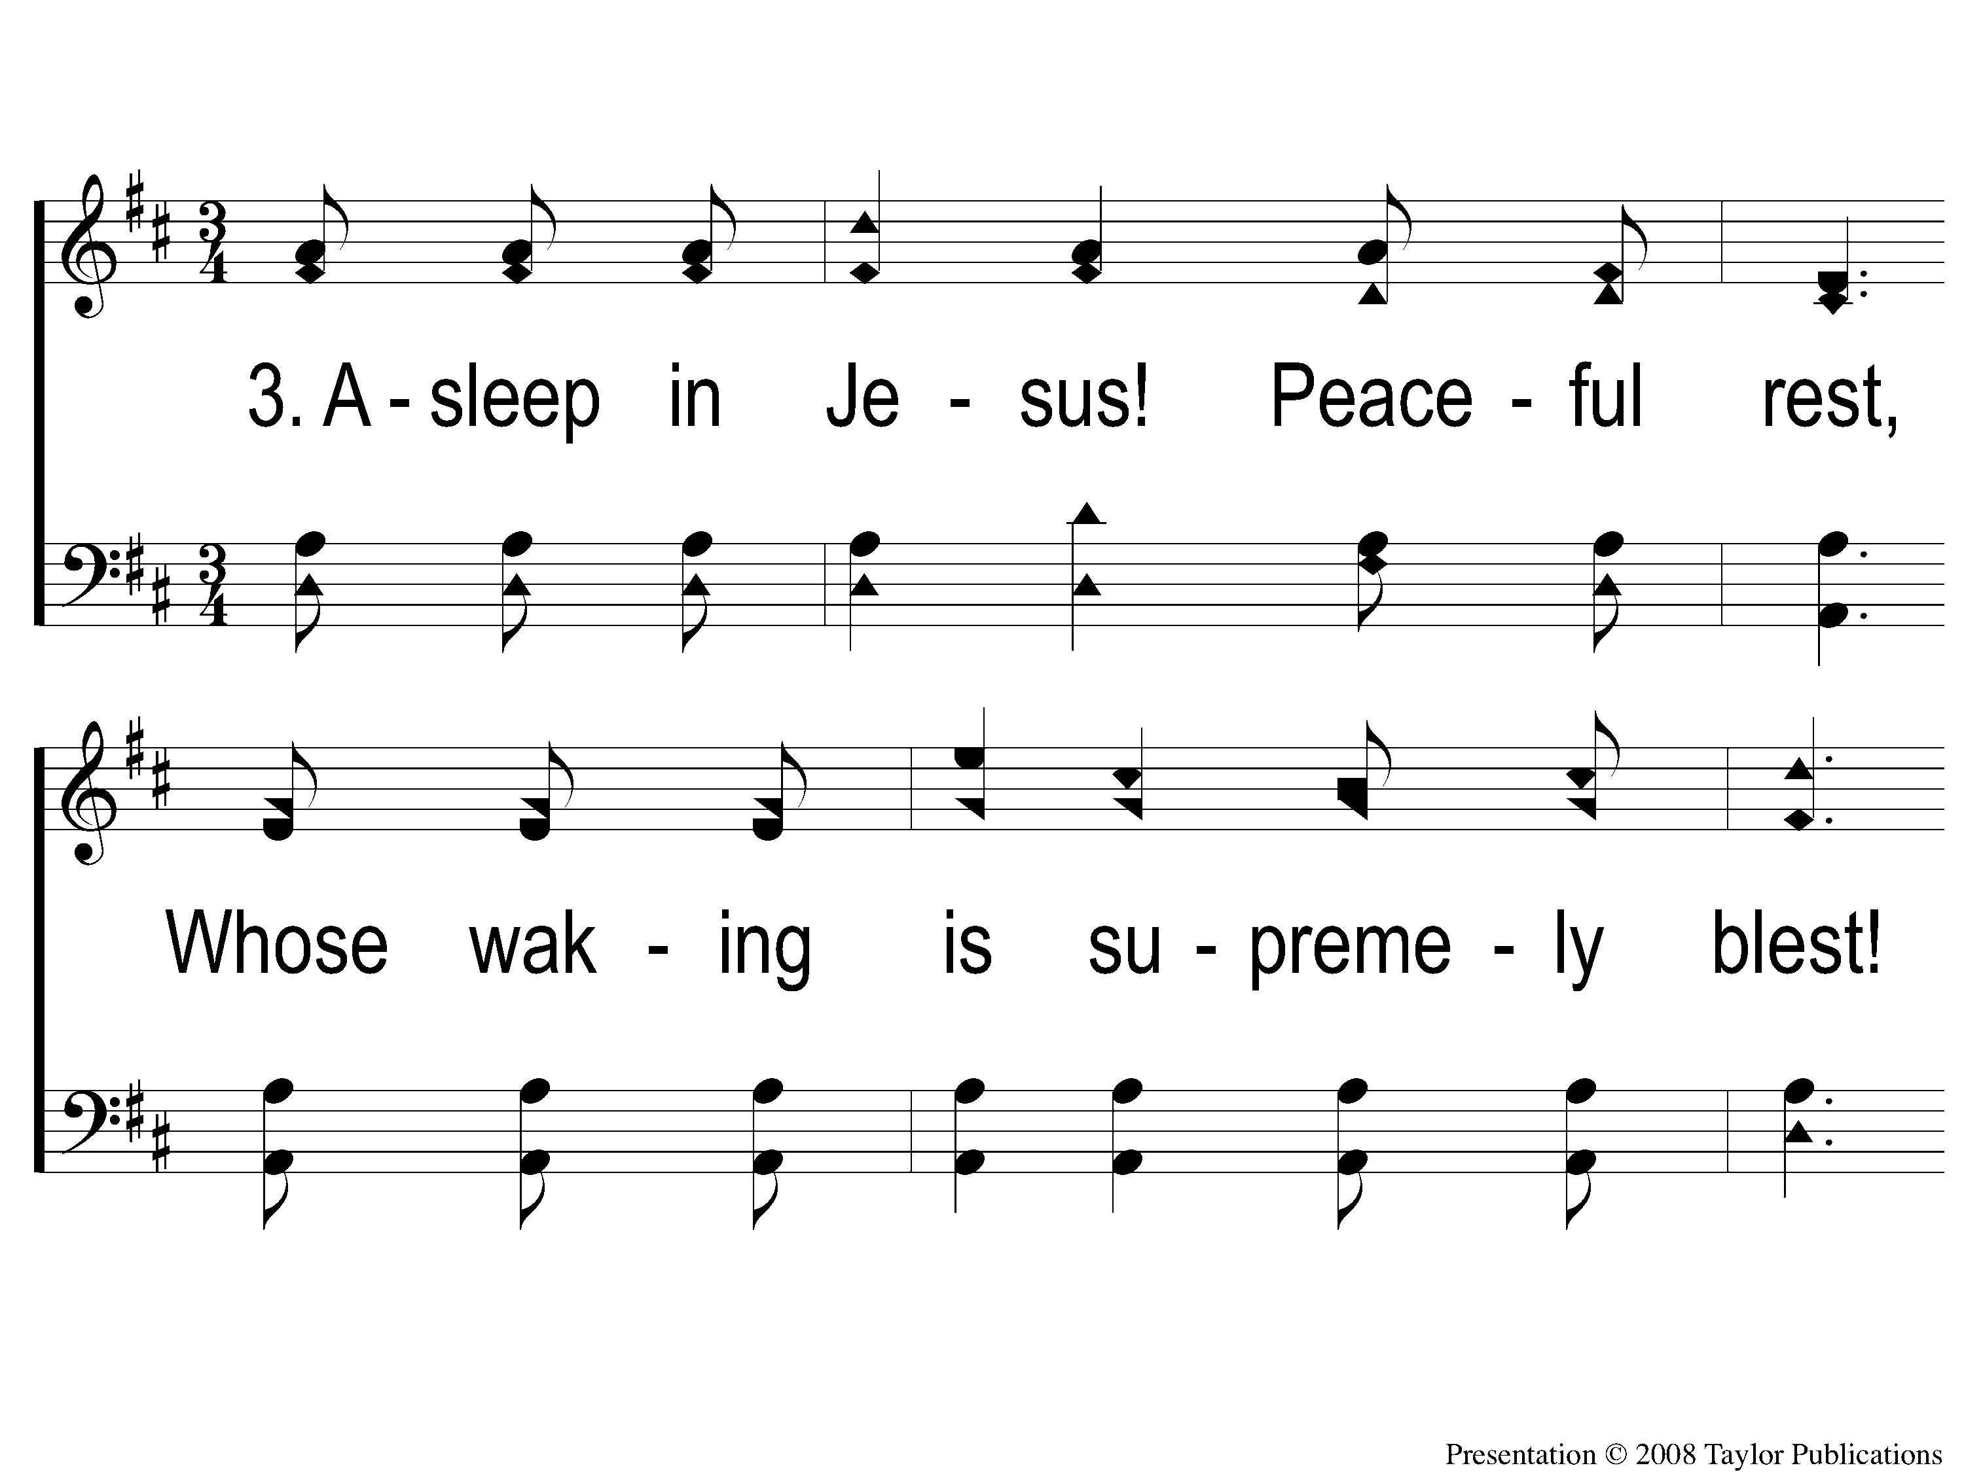
3-1 Asleep In Jesus
Asleep In Jesus
4

Slide 6
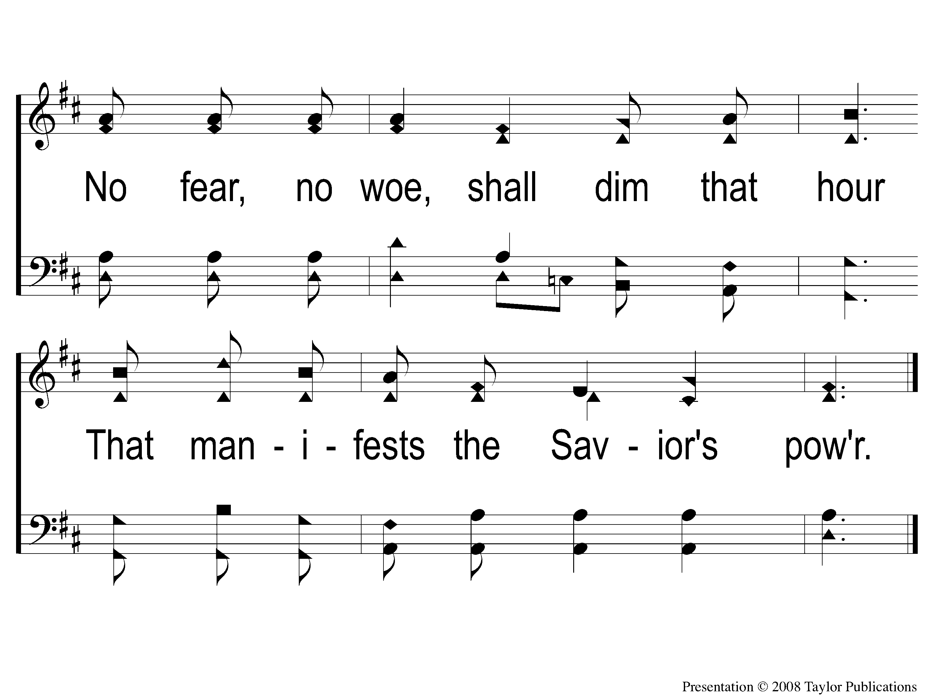
3-2 Asleep In Jesus
Asleep In Jesus
4

